Slide 1
Food and Beverage Management
The Menu

Slide 2
It all starts here – the Menu
The Menu established the tone, organization and management of the food service establishment
Communicates the image, price and mood
Sets the tone for the dining experience

Slide 3
Marketing
The menu is the chief in house marketing tool
Must convey the right message
Appropriate Copy
Good Condition
Fits with the vision of the establishment

Slide 4
Commercial Pricing Styles
Basic Categories
Table d'hôte
A La Carte
Combination

Slide 5
Table d'hôte
Offers a complete meal for one price
May have several meals on menu
Some offer limited choices within menu categories
Sometimes called “prix fixe”

Slide 7
A La Carte & Combination
A La Carte
Foods are listed and priced separately
Combination
A La Carte menus offer a combination – salads, etc with the entrée
May also offer a Table D'hôte menu and a la carte items

Slide 8
Non Commercial Menu Styles
Many offer the same styles as the commercial operators
Private clubs
Quick Service in Hospital or Business Setting
With or without prices
All have two things in common
Inform Guests
Drive planning for supporting resources

Slide 9
Menu Schedules
Fixed
Typically in hotels and chain restaurants
Menu can remain the same for several months
Work best at establishments visited occasionally
Cycle Menus
Designed to provide variety for guests who eat at an operation frequently –
Can range from a week to four weeks –
Too short a cycle – menus may repeat to often
Too long – production savings deteriorate
Menus can be A La Carte or Table D'hôte

Slide 11
Types of Menus
Breakfast
Fairly standard
Simple, fast and inexpensive
Lunch
Diners are usually time limited
Should have variety
Use specials to retain frequent guests
Offer smaller portions if entrees duplicated for dinner
Less elaborate
Dinner
Main meal of the day
Likely to be eaten at a leisurely pace
Typically costs more
Premium on service, atmosphere and décor
Wide variety of selections

Slide 12
Specialty Menus
Children’s
Seniors
Alcoholic Beverages
Dessert
Room Service
Take out
Banquet
California
Ethnic

Slide 13
Specialty Menus
Children
Bright Colors –
Games – occupy kids so parents can eat
Foods should be familiar, nutritious and simple
Can be more upscale at fine dining restaurants
Senior
Can be separate
Typically – foods for seniors are mixed in with other menu items
Note ingredients and preparation methods

Slide 14
Specialty Menus
Alcoholic Beverages
Cocktails
Wine lists
Dessert
Separate menus offer more desserts
More room for pictures and descriptions
Can address dessert specials
Changes in prices do not force reprints
More space if available on main menus for entrees, etc

Slide 15
Specialty Menus
Room Service
Simple items work best
Need to be delivered hot
Door Knob Breakfast menus
In room TV orders
Take Out
May have dedicated facilities for take out ordering
Banquet
Pricing style is typically table d'hôte
Foods offered should be easy to prepare in quantity without sacrificing production

Slide 16
Specialty Menus
California
Breakfast, lunch and dinner available 24 hours a day
Offering this type of menu sacrifices production and scheduling convenience
Ethnic
Can offer tastes to the market, i.e. American “Hot” vs Thai “Hot”

Slide 17
Menu Planning Basics
Menu Planning can be complex
Commercial – may be planned by a chef or corporate team
Non Commercial – may be planned by dietitian
Need to know the operation
Pricing Style
Type of menu

Slide 18
3 Basics
Know your Guests
Consider guest preferences - not your own
Know your quality requirements
Flavor
Consistency
Texture
Form and shape
Nutritional
Know your operation
Theme
Cost
Equipment
Layout
People

Slide 21
Selecting Menu Items
Use resources
Old Menus
Dine out and pick up ideas
Books
Magazines
Cook Books
Websites
Consultants

Slide 22
Trimming the menus
Make sure that “ego” doesn’t get involved
Items should be eliminated if they:
Cost too much
Incompatible with the theme
Unavailable equipment
Insufficient equipment
Inadequate kitchen
Not enough staff
Staff skill levels
Availability of ingredients
Cannot meet Quality Standards
Potential sanitation problems

Slide 23
Building the menu
Select Entrée First
Too many entrées can can operating issues
Appetizers
Starches and vegetables
Can be a part of the entrée – ex. – pasta bolognese
Salads
Side dishes or entrées?
Salad bars
Desserts
Typically high profit
Beverages
Specialty coffees - microbrews

Slide 24
Menu Balance
Business Balance
Food costs, menu selling prices, item popularity, menu should drive financial goals - keep reviewing
Aesthetic Balance
Colors, textures, flavors
Nutritional Balance
Balance of foods – offer healthier items

Slide 25
Menu Design
Should be well organized
Depends on the type of operation
Chains have specialists who design menus
Many times consultants and designers are used

Slide 26
Elements of Design - Copy
Headings
Appetizers, etc.
Choose names with care
If items are in a foreign language – have simple descriptions in English
Pictures are important
Descriptive Copy
Informs guests about the menu items and helps increase sales
Grammar is important
Entrées and high profit items should get the mot copy
Follow Truth in Menu laws
Supplemental Copy

Slide 27
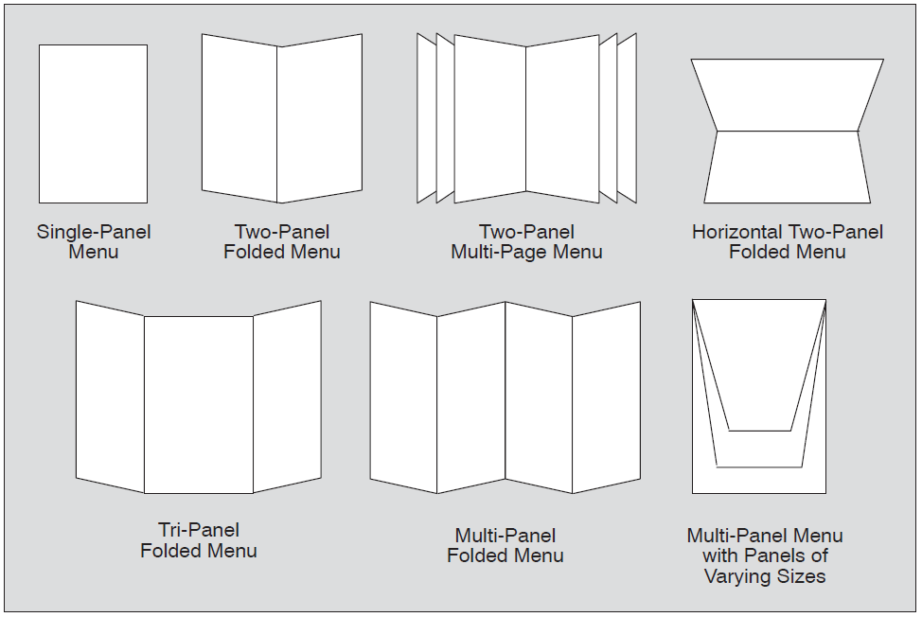
Menu Formats

Slide 28
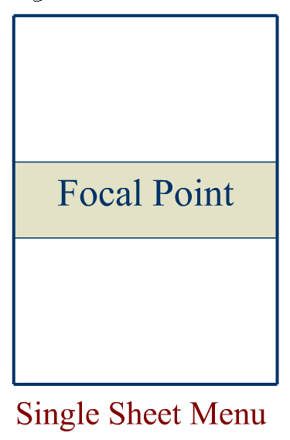
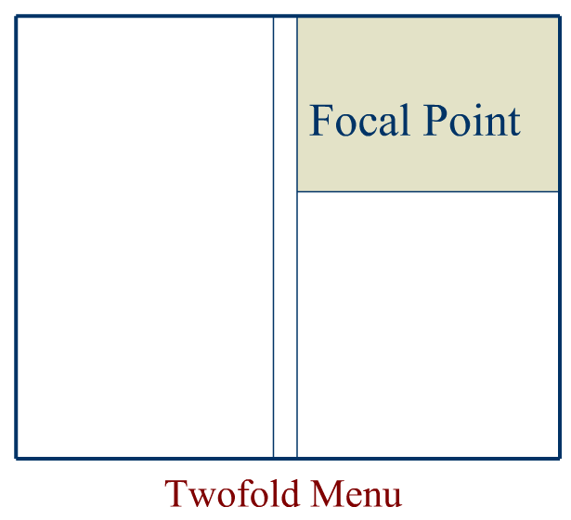
Focal Points

Slide 29
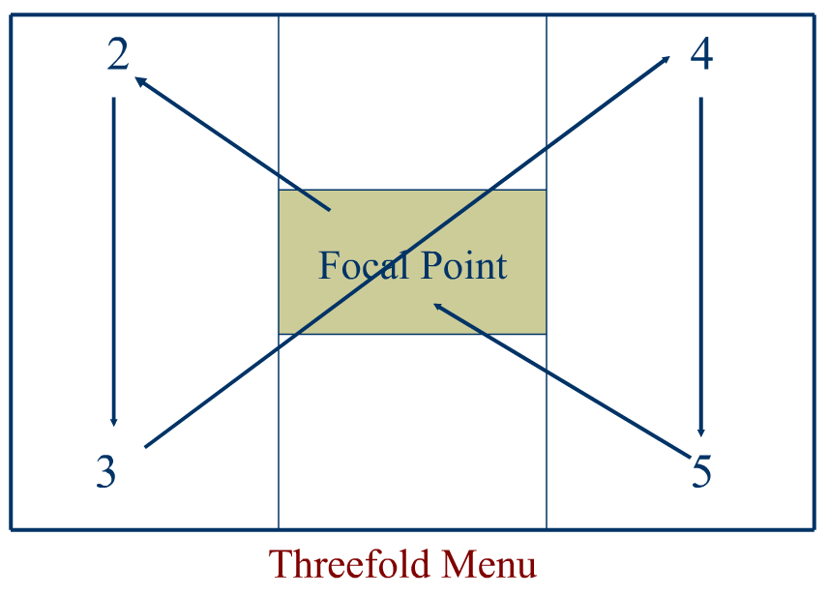
Focal Points

Slide 30
Truth in Menu
Grading
Meat grades, etc
Freshness claims
Freshly frozen
Geographical Origins
Preparation
Dietary or Nutrition Claims
Portion Sizes
Proper name –
Is it really grouper?

Slide 31
Elements of Design - Layout
Sequence
Meals have a beginning and an end
Order of placement is by popular/profitable
Placement
Use design – make sure enough “white space”
Format
Size, Shape and general make up
Space should be a balance of design and information
Typeface
Make it readable
Artwork
Do not clutter
Paper

Slide 32
Elements of Design - Covers
Covers define the experience – “Moment of Truth”
Should not appear cluttered
Should be heavy duty, durable & grease resistant
Suitable to the operation
Colors chosen with care
Pastels suggest warmth
Purples and blacks suggest richness
Can be used (sparingly) on interior pages

Slide 33
Common Mistakes
Menu is too small
Type is too small
No or little descriptive copy
Every item is treated the same
Some things are not listed
Clip on problems
Basic information (i.e. phone #) not listed
Blank pages
If on line make sure that version is up to date!!!

Slide 34
Evaluating
Set benchmarks and goals
Menu Engineering:
Popular?
Profitable?
Answers to:
Guest reactions to menu
Pricing is correct
Check average
Laid out properly
Does it have the right mix

Slide 35
Modern tools
Menu Management Software
What is most profitable price
What price level and mix maximizes profits
Which current items need re pricing, retention or repositioning or replacement
How should specials and new items be priced
How can success be evaluated

Slide 36
Modern Tools
Precosting Software
Estimate profitability before production and service
Postcosting Software
Based on actual sales
Menu Engineering Software
Menu Mix – sales of an item vs. the whole
Stars – popular and most profitable
Plowhorses – popular and less profitable
Puzzles – not popular but highly profitable
Dogs – exactly what it sounds like!!!!

